Slide 1
Application Security Services Secure by Design
Security and GBS partnership & Go to Market plan
CHRISTOPHE CHAU
Senior Managing Consultant
Global Center Of Competencies
Data & Application Security Services
cchau@us.ibm.com
January 2018

Slide 2
Secure By Design : Why?
Why create applications Secure by Design?
Secure by Design can only be achieved with a mature approach of security.
Security implementation is planned with a programmatic approach, and is integrated into our processes and culture.
End-to-End approach of securing applications, connecting secure development practices to security testing activities.
Pro-active identification of security design flaws and vulnerabilities; Security Controls and counter-measures are implemented accordingly.
Message to our clients :
We know what we are doing
We have a mature security approach that eliminate improvisation
Notes:
Capability slide that shows the major focus areas for the capability

Slide 3
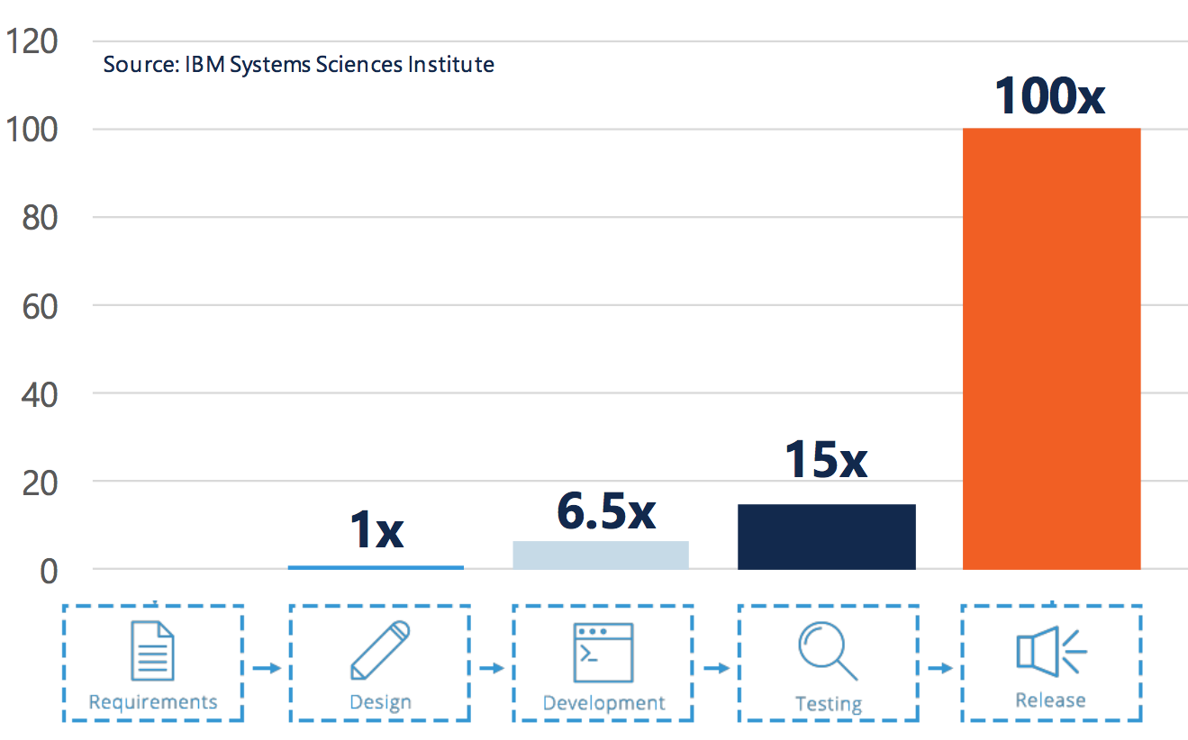
Secure By Design : The Benefits 1/2
Drive down the cost of securing applications
The cost of fixing security vulnerabilities increase exponentially
Addressing security early is key in running a cost efficient application security program
Secured applications by design, with in depth defense mechanisms, offer a better Return On Investment than creating security fixes at the last minute.
Notes:
Capability slide that shows the major focus areas for the capability

Slide 4

Secure By Design : The Benefits 2/2
Drive down the cost of securing applications
Vs.
Vulnerabilities are found by security auditors prior to going live or even later
Vulnerabilities will be minimized if security is built in early on
% of Issue Found by Stage of SDLC
% of Issue Found by Stage of SDLC
Design
Coding
Testing
Production
Design
Coding
Testing
Production
Backward secure SDLC processes that rely on security testing results to determine secure development requirements.
Development teams create “quick and dirty” vulnerabilities fixes due a lack of planning, time, skillset, and proper funding / resource.
Pro-active secure SDLC approach to drive down cost of securing applications by early integration.
Secured application by design, with in depth security mechanism, instead of “Band-Aid” remediation solutions.
Secure coding guidance provided just in time for each development task.
Notes:
Capability slide that shows the major focus areas for the capability

Slide 5
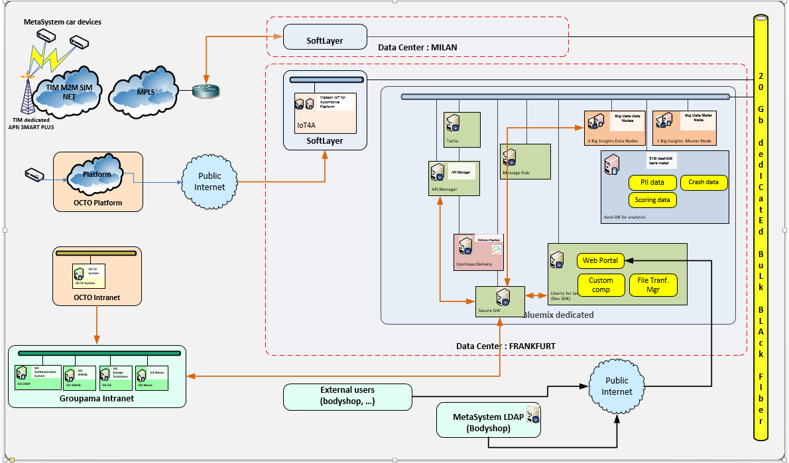

Secure SDLC Model Example
Application Security Strategy & Program
Secure Development
Provide security directions and objectives for development teams.
Planned security implementation.
Security controls mechanisms embedded into the application design.
Just in time guidance for development tasks.
Security Testing
Leverage various testing technique for different needs at different time.
Verification that security requirements are fulfilled.
Testing results used for feedbacks and continuous improvement of development practices.
Security Awareness
Secure Development Training
Security Requirements definition
Security Architecture & Design
Secure Coding
Guidance
Threat Modeling
Static Application Security Testing
Application Penetration Testing
Dynamic Application Security Testing
Security test cases aligned with requirements
Secure Applications
Requirements Analysis
Design
Coding
Testing
Release
Software Development LifeCycle (SDLC)
Notes:
Capability slide that shows the major focus areas for the capability

Slide 6






Our Offerings Structure
Application Security Program Services
6948-66X (8F)
6948-54N (8F GBS)
6948-67D (J6 GTS)
Secure Development Training Services
6948-66Z (8F)
6948-67F (8F GBS)
6948-67A (J6 GTS)
Secure Development Support Services
6948-66Y (8F)
6948-67G (8F GBS)
6948-67C (J6 GTS)
Application Security Testing Services
6948-66W (8F)
6948-67H (8F GBS)
6948-67E (J6 GTS)
Managed Application Security Services
6948-68N (8F)
6948-68L (8F GBS)
6948-68M (J6 GTS)
Notes:
Capability slide that shows the major focus areas for the capability

Slide 7



Application Security Program Services
Offering overview
Application Security Program Services
Organization | Governance | Processes | Metrics | Technology
Objectives
Help clients to define an application security strategy to manage, develop and test their application in line with business needs. Establish the application security baselines for a programmatic approach adoption.
Approach
Program Design & Development Maturity Assessment Evaluation of clients application security program against industry-accepted standards, compliance requirements and industry best practices. Identify clients desired maturity state and gaps to be addressed. Develop an action plan and roadmap to help client to achieve its security objectives Program Design & Development Create application security program artefacts, aligned with industry best practices.
Deliverables
Maturity Assessment Maturity assessment report Gap analysis and recommendations Transformation plan and roadmap Application Security Program Design & Development Application security policies, standards and processes. organizational structure governance model security policies and standards security processes reporting metrics.

Slide 8
Secure Development Training
Offering overview
Secure Development Training
eLearning | SaaS or On-Premise | Just-in-time Training
Objectives
Build a security-centric culture within the client’s development organization Promote security awareness among SDLC stakeholders, and educate architects and developers on secure development / coding concepts and best practices.
Approach
Partnership with Security Compass for reselling their eLearning solution : SOFTWARE SECURITY PRACTITIONER (SSP) SUITES eLearning course tailored to specific SDLC roles or programming languages. Industry-recognized educational material by (ISC)².
Deliverables
Access to partial or full eLearning library eLearning available in SaaS or On-Premise option. 10 SSP Suites are offered in partnership with (ISC)². A learner is certified as a Software Security Practitioner once they successfully complete all courses within the suite and pass an SSP Exam

Slide 9
Software Security Practitioner (SSP) Suites
10 SSP Suites are offered in partnership with (ISC)²
A learner is certified as a Software Security Practitioner once they successfully complete all courses within the suite and pass an SSP Exam
There is no additional cost to complete the exam or to obtain certification

Slide 10
Secure Development Support Services
Secure Development Support Services
Security Requirements | Threat Modeling | Security Architecture
Offering overview
Objectives
Help clients to strategically plan security integration during application development process. Identify security requirements proactively to provide development teams with directions and security objectives. Adopt a risk-driven model while designing applications’ security architecture by using threat modeling.
Approach
Secure SDLC Analysis & Design Define a secure SDLC strategy and processes integrating security activities. Requirements Management Assistance in identifying security requirements for each application development iteration with SD Elements Threat Modeling List potential threats, attack vectors & scenarios to induce a risk-driven approach for handling secure development priorities. Architecture Analysis Assess applications' security architecture, mechanism and controls against industry best practices.
Deliverables
Secure SDLC Analysis & Design Secure SDLC policy, processes definition Requirements Management Secure development tasks with supporting guidance, aligned with application’s security requirements. Threat Modeling Threat models with risk ranking Architecture Analysis Security architecture report listing design flaws, possible weaknesses in existing security control mechanisms.

Slide 11
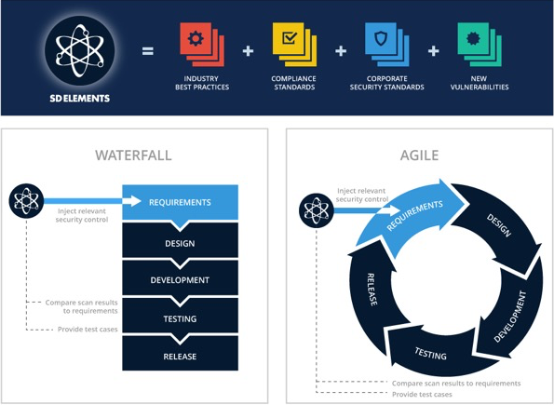
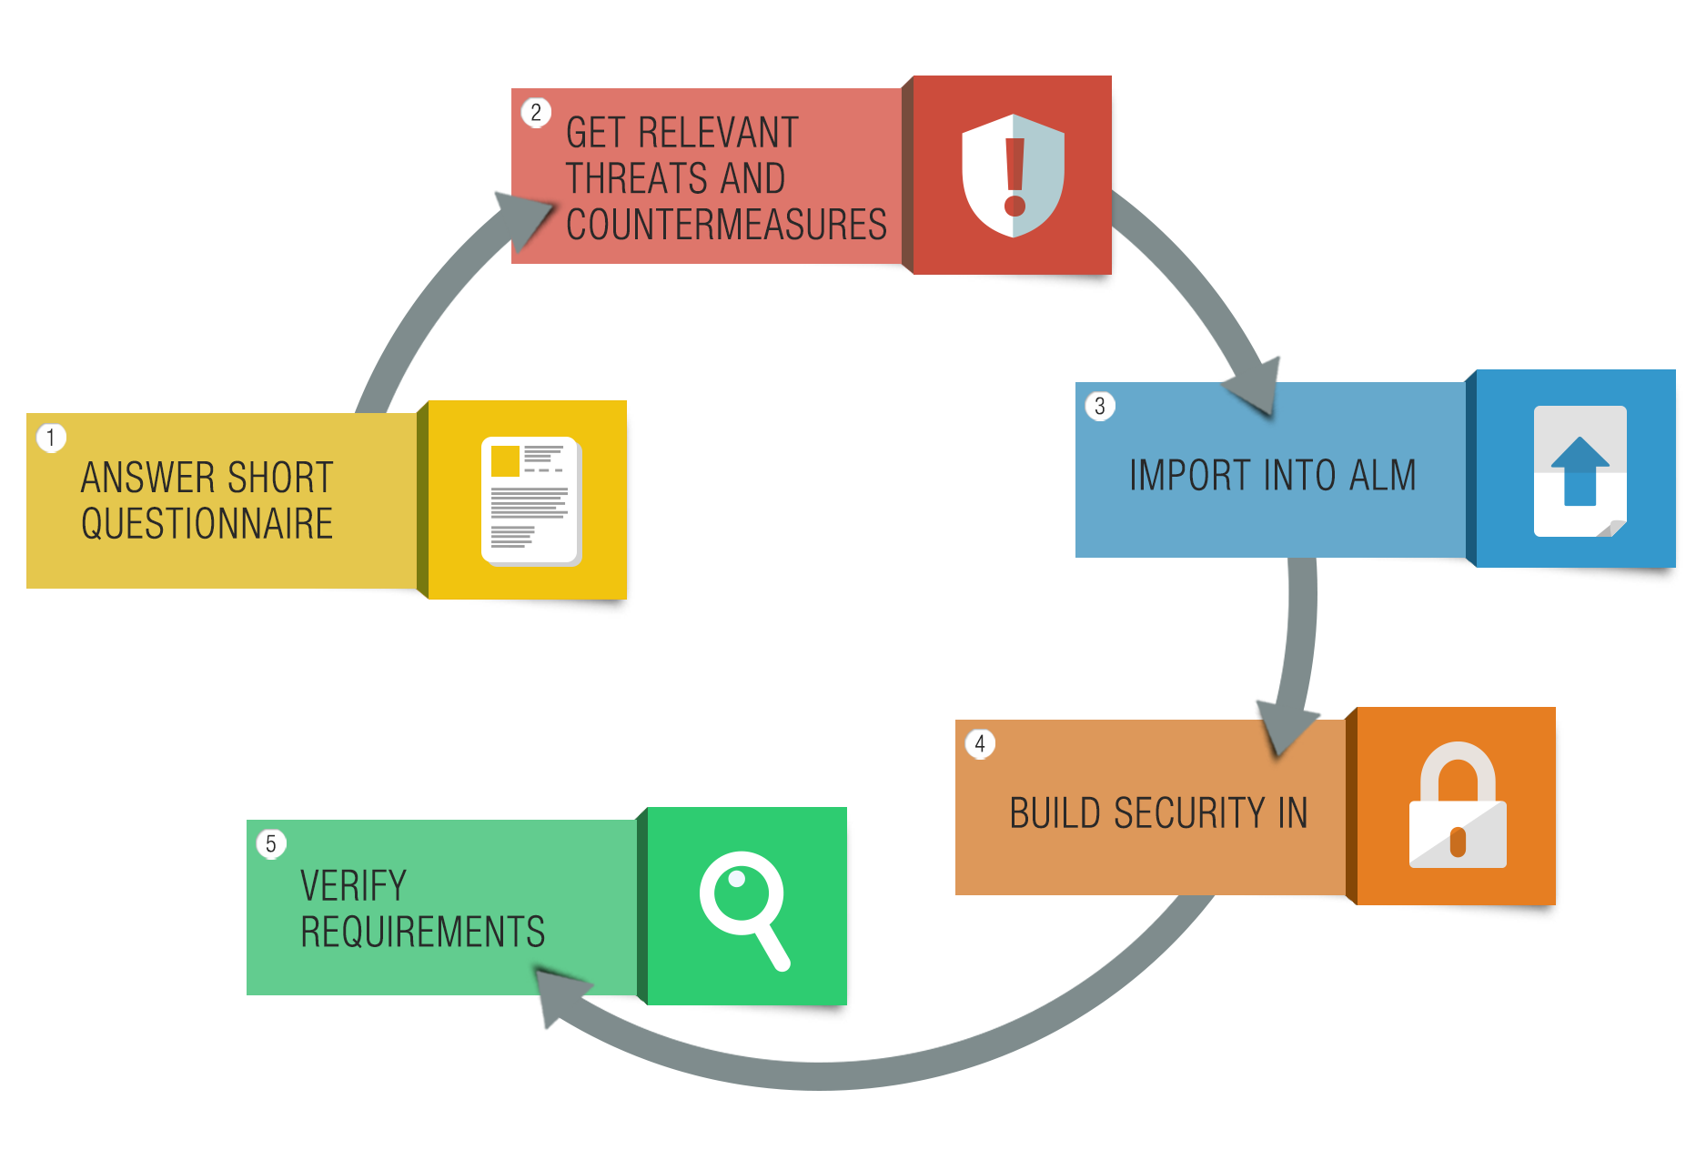
Security Requirements Management with SD Elements
Answer a short questionnaire to identify security requirements specific to your application profile.
Get relevant threats and counter-measures Development tasks with implementation guidance is generated to meet the security requirements or specific regulation framework. Easy compliance check.
Import into your ALM tool for a seamless integration of security requirements into your existing development tools
Build security in – SD Elements provides security recommendations and code samples to implement security requirements in a variety of languages and frameworks.
Verify requirements – Step-by-step testing procedures available, along with the option to import testing results from security scanning products to validate correct implementation of the security requirements.

Slide 12
Application Security Testing Services
Offering overview
Application Security Testing
Source | Runtime | Network | Hardware | Human
Objectives
Provide clients access to the state of art of application security testing techniques and expertise. Define an adequate application security testing strategy and process specific to each SDLC model, and integrated into the application development process. Ensure application security requirements are met with correct implementation of security controls mechanisms.
Approach
Security Testing Strategy Development Optimize security testing effort by leveraging the right technique at the right time. Create continuous improvement process Remediation Support Application Security specialist assistance in reviewing vulnerabilities found during testing, and remediation solution recommendations. X-Force Red Security Testing C.f. IBM X-Force Red offerings
Deliverables
Security Testing Strategy Development Strategy, policy & procedures, processes definition for application security testing, vulnerability management, continuous improvement of development practices, etc. Remediation Support Workshops conducted by application security specialist to review security findings and recommendations. X-Force Red Security Testing C.f. IBM X-Force Red offerings

Slide 13
Managed Application Security Services
Offering overview
Managed Application Security Services
Managed SDLC | Managed Security Testing | Managed Web Application Firewall
Objectives
Provides clients access to trained resources to run application security processes and activities. Technical support for tools administration, configuration, maintenance, and operation. Act as an extension of clients’ application security team. Any application security services can be delivered as a managed services, since application development activities are a on-going process.
Approach
Requirement Management Remediation Support Threat Modeling (future) Architecture Analysis (future) Web Application Firewall Maintenance (future) X-Force Red Testing Services Subscription - C.f. IBM X-Force Red offerings
Deliverables
Requirement Management Remediation Support Threat Modeling (future) Architecture Analysis (future) Web Application Firewall Maintenance (future) X-Force Red Testing Services Subscription - C.f. IBM X-Force Red offerings

Slide 14
Offering solutioning details Application Security Program Services

Slide 15
Application Security Services – Portfolio
Offering Name / Service Name | L30s / L40s Code
Application Security Services (C&SI) (L30) | 6950-19S (8F) 6950-19Z (8F GBS) 6950-19T (J6 GTS)
Application Security Program Services (L40) Program Design and Development | 6948-66X (8F) 6948-54N (8F GBS) 6948-67D (J6 GTS)
Secure Development Training Services (L40) | 6948-66Z (8F) 6948-67F (8F GBS) 6948-67A (J6 GTS)
Secure Development Support Services (L40) Secure SDLC Analysis & Design Threat Modeling Architecture Analysis Requirements Management | 6948-66Y (8F) 6948-67G (8F GBS) 6948-67C (J6 GTS)
Application Security Testing Services (AppSec) (L40) Security Testing Strategy Development Remediation Support | 6948-66W (8F) 6948-67H (8F GBS) 6948-67E (J6 GTS)
Application Security Services (Managed) (L30) | 6950-20M (8F) 6950-20K (8F GBS) 6950-20L (J6 GTS)
Managed Application Security Services (L40) TBD – future | 6948-68N (8F) 6948-68L (8F GBS) 6948-68M (J6 GTS)
Offering maintained by
IBM Security
Europe Center of Competency (COC)
Data & Application Security Services (DAS)
Privileged contacts :
Gregg Barrow
DAS Partner
gbarrow@us.ibm.com
+1 203-885-8105
Dinesh Nagarajan
DAS Associate Partner
Dinesh.Nagarajan@uk.ibm.com
+44 7393761660
Christophe Chau
DAS Senior Managing Consultant
cchau@us.ibm.com
+1 917-868-9461

Slide 16
Application Security Program Services - Program Design & Development (1/2) 6948-66X (8F) 6948-54N (8F GBS) 6948-67D (J6 GTS)
Solution Overview & Capability
Strategy advisory services – include 2 components that can be sold separately, to address specific focus
Selection Criteria & Positioning
“Compares to the IBM 10EP assessment, it is a deep dive into application security domain
This offering should be privileged when application security is a particular point of client’s attention
The consulting approach is based on industry best practices – with the ideal client being a organization with low maturity
The entire “Program Design & Development” are more adapted to medium / large organizations with strategic approach
“Secure SDLC Analysis & Design” and “Security Testing Strategy Development” are for small organizations with a tactical approach
Scoping & Estimating
The consulting effort depends on the client organization complexity, which are simplified based on the following sizing criteria:
Governance model (centralized / decentralized)
Development team size ( provide an idea of the volume of development activities
Number of SDLC models (by default 1, additional requires about +10% cost)
Application Security Program Services Program Design & Development
Secure Development Support Services Secure SDLC Analysis & Design | Application Security Testing Services Security Testing Strategy Development

Slide 17
Application Security Program Services - Program Design & Development (2/2) 6948-66X (8F) 6948-54N (8F GBS) 6948-67D (J6 GTS)
Value Proposition
These strategic advisory services help client to address the questions :
How do I manage my application security program? What is the best strategy for my organization?
How do I enable secure development practices? How do I integrate security into the Software Development LifeCycle?
What kind of security testing solution do I need? What is the best testing strategy? How do I optimize my current testing activities?
These services open discussions that lead to additional services (C&SI, MSS, staff augmentation) / product sale opportunities
“Secure SDLC Analysis & Design” naturally leads to the others Secure Development Support Services
“Security Testing Strategy Development” leads other Application Security Testing Services, including IBM X-Force Red Testing Services
Delivery Model
Strategic advisory services that usually requires leading resources to be on-site, supported by COC
Indicative Costing & Pricing Guidance
Standard WBS template available - supported by sizing criteria to adjust the effort estimate. (~5 weeks duration)
From ~50k USD to +200k USD for “Program Design & Development”
From ~30k USD to 100k USD for “Secure SDLC Analysis & Design” or “Security Testing Strategy Development”
Executive oversight ~5% | Execution supervision ~20% | Delivery ~75%
Local or COC (Band 10-D) | COC (Band 8-9) | Local or COC (Ban 6-8)

Slide 18
Secure Development Training Services (1/2) 6948-66Z (8F) 6948-67F (8F GBS) 6948-67A (J6 GTS)
Solution Overview & Capability
Partner product from Security Compass - straight resale
Role-based training is offered through SSP Suites in an exclusive partnership with (ISC)2
A learner is certified as a Software Security Practitioner once they successfully complete all courses within the suite and pass an SSP Exam
Selection Criteria & Positioning
Typical client profile : organizations with significant in application development activities, and that needs to train their developers to secure coding practices
Course content available in English only. Translation in other language may be possible in the future
Scoping & Estimating
License fee : Yearly subscription structured as a fixed price per user band for a given number of courses. Along with 1 course, 5 course and Full Library pricing we are introducing a new offer – access to any SSP Suite (1 SSP Suite per user)
Hosting :
SaaS : Adapted for organization with small amount of users
On-Premise : More suitable for large users volume where clients have their own Learning Management Systems (LMS)

Slide 19
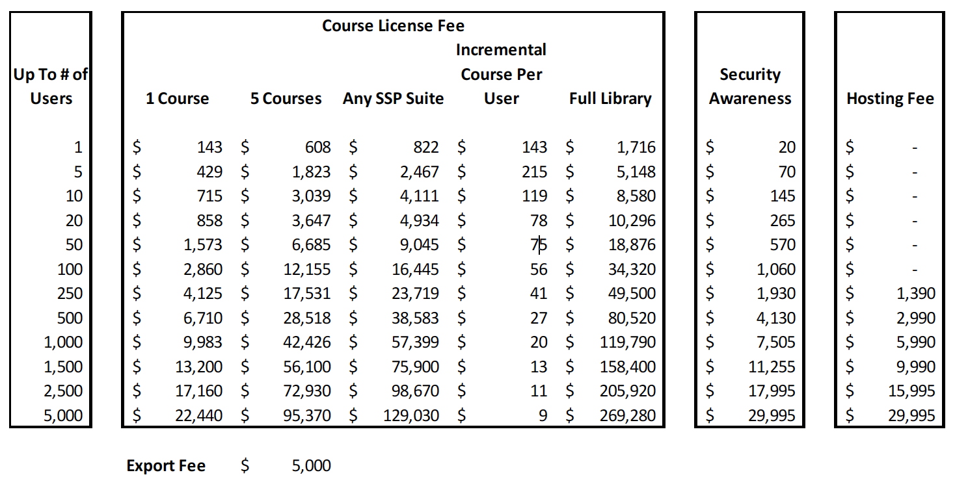
Secure Development Training Services (2/2) 6948-66Z (8F) 6948-67F (8F GBS) 6948-67A (J6 GTS)
Value Proposition
This offering exist to allow IBM to be an one stop shop that provide everything thing client needs regarding application security
Training developers to secure coding practices is necessary for them to understand how to address / prevent security vulnerabilities
Implementation Guidance
SaaS option– user accesses managed by Security Compass
On-Premise option – ELearning content provided as SCORM file package - Clients LMS must be compatible with SCORM standards – Required content export fee
Indicative Costing & Pricing Guidance
IBM discount is 25% On Course License Fee
Discount does not apply to Hosting Fee
There is a separate cost for hosting for some bands/number of courses
No hosting cost for some user bands (<100 users)

Slide 20
Secure Development Support Services - Threat Modeling (1/2) 6948-66Y (8F) 6948-67G (8F GBS) 6948-67C (J6 GTS)
Solution Overview & Capability
Consulting services supporting application development activities
Application Threat and Risk analysis approach using industry recognized STRIDE and DREAD classification scheme
Future development will include a third-party tool to allow scaling to support large volume
Selection Criteria & Positioning
Typical client profile : Organizations with a certain level if awareness of security architecture and design standards, seeking to adopt a risk based prioritization approach
Can be jointly proposed with the complementary service : Architecture Analysis
Scoping & Estimating
The consulting effort depends on application’s complexity and documentation available
Each threat modeling exercise cover one application, for a given set of security requirements
To determine if an application requires more than one threat modeling, developers ask :
Has something regarding assets changed?
Has something regarding security controls changed?
Has something regarding the attack surface changed?
Has something regarding threat agents changed?
Rule of thumb : By default one Threat Modeling per application, then discuss with client if additional is needed

Slide 21
Secure Development Support Services - Threat Modeling (2/2) 6948-66Y (8F) 6948-67G (8F GBS) 6948-67C (J6 GTS)
Value Proposition
There are more application security architecture and design principles than developers can afford to implement
Threat Modeling help to adopt a risk based approach in prioritizing implementation of security architecture and design features
Finds architectural and design flaws that are difficult or impossible to detect through other methods
Delivery Model
Services supporting application development activities could be delivered remotely, if not requested to be on site
Indicative Costing & Pricing Guidance
Standard WBS template available, supported by sizing criteria to adjust the effort estimate. (~2-3 weeks duration)
From ~15k to 30k /USD for one time charge per application – pricing will drop if the service is recurrent on the same scope of applications
If combined with Architecture Analysis services on the same scope, overall cost could decrease of about 25%
Executive oversight ~5% | Execution supervision ~ 5% | Delivery ~90%
Local or COC (Band 10-D) | COC (Band 8-9) | Local or GID (Ban 6-8)

Slide 22
Secure Development Support Services - Architecture Analysis (1/2) 6948-66Y (8F) 6948-67G (8F GBS) 6948-67C (J6 GTS)
Solution Overview & Capability
Consulting services supporting application development activities
One time services to analyze an application’s security controls and defense mechanism against OWASP industry best practices
Selection Criteria & Positioning
Typical client profile : Organizations with a desired to gain maturity in application security, looking for standardizing an security architecture standard or proactively address security considerations in the SDLC
Mostly suitable for with organizations that do in-house application development
Can be jointly proposed with the complementary service : Threat Modeling
Scoping & Estimating
The consulting effort depends application’s complexity and documentation available
Each architecture analysis cover one application, for a given set of security requirements
Rule of thumb : By default one architecture analysis exercise per application, then discuss with client if additional is needed

Slide 23
Secure Development Support Services - Architecture Analysis (2/2) 6948-66Y (8F) 6948-67G (8F GBS) 6948-67C (J6 GTS)
Value Proposition
There are more application security architecture and design principles than developers can afford to implement
Threat Modeling help to adopt a risk based approach in prioritizing implementation of security architecture and design features
Finds architectural and design flaws that are difficult or impossible to detect through other methods
Delivery Model
Services supporting application development activities could be delivered remotely, if not requested to be on site
Indicative Costing & Pricing Guidance
Standard WBS template available, supported by sizing criteria to adjust the effort estimate. (~2-3 weeks duration)
From ~15k to 30k /USD for one time charge per application – pricing will drop if the service is recurrent on the same scope of applications
If combined with Threat Modeling services on the same scope, overall cost could decrease of about 25%
Executive oversight ~5% | Execution supervision ~ 5% | Delivery ~90%
Local or COC (Band 10-D) | COC (Band 8-9) | Local or GID (Ban 6-8)

Slide 24
Secure Development Support Services - Requirements Management (1/3) 6948-66Y (8F) 6948-67G (8F GBS) 6948-67C (J6 GTS)
Solution Overview & Capability
Include resale of a IBM partner product : SD Elements from Security Compass
T&T (Transformation & Transition) phase includes definition of secure SDLC processes, and provisioning & customization of SD Elements
BAU ( Business As Usual) covers on-going support of process and product
SD Elements works in complement with security testing solutions ( i.e. AppScan or X-Force Red testing services)
SD Elements identifies security requirements specific to each application, including major security framework and regulation ( i.e. PCI DSS, GDPR, HIPAA, etc.)
Selection Criteria & Positioning
Pre-requisite : Secure SDLC Analysis & Design need to be performed to some extend, as SD Elements is heavily based on processes
Typical client profile : Organizations that have a sufficient in-house application development activities, the solution has lesser benefit when used on COST / vendor applications
SD Elements has virtually no competition – new category created just for them in Gartner report
Scoping & Estimating
T&T : Customization needs : custom requirements can be created from unsupported security framework, regulations, or client specific policy and procedures documentation. ~5k USD per additional framework – Need custom estimate
BAU :
Product : How many application in scope? SD Elements offers yearly subscription with applications-based licensing model
Services :Estimation done per FTE unit for supporting the BAU – 1 FTE can support up to 40 request monthly

Slide 25
Secure Development Support Services - Requirements Management (2/3) 6948-66Y (8F) 6948-67G (8F GBS) 6948-67C (J6 GTS)
Value Proposition
Identifying security requirements is critical step that define all the rest of secure development activities, but usually overlooked due a lack of management support, funding, understanding or skillsets
SD Elements allow us to propose an solution that cover end-to-end application security needs, and integrated with others IBM solutions and services
Delivery Model
2 phases approach :
Implementation Guidance
SaaS option– SD Elements user accesses managed by Security Compass
On-Premise option – Solution provided in the form of virtual machines
Integration with ALM tools (i.e. Rational Team Concert)
Integration with security testing tools (i.e. AppScan / ASOC)
Indicative Costing & Pricing Guidance
50% off of MSRP price for SD Elements Enterprise tier. IBM will set the price for their clients independently
The partner price discount applies to Over-Usage and Under-Usage as well. However, the partner discount does NOT apply to the Server Fee
Example for 50 apps for 1 year : ~ 225k USD product cost + 400k USD IBM services / running cost ~200k USD IBM Services
 | T&T | BAU
Executive oversight | ~5% Local or COC (Band 10-D) | ~5% Local or COC (Band 10-D)
Execution supervision | ~5% COC (Band 8-9) | ~5% GID (Band 8-9)
Delivery | ~90% Local or GID or COC (Ban 6-8) | ~90% GID (Ban 6-8)

Slide 26

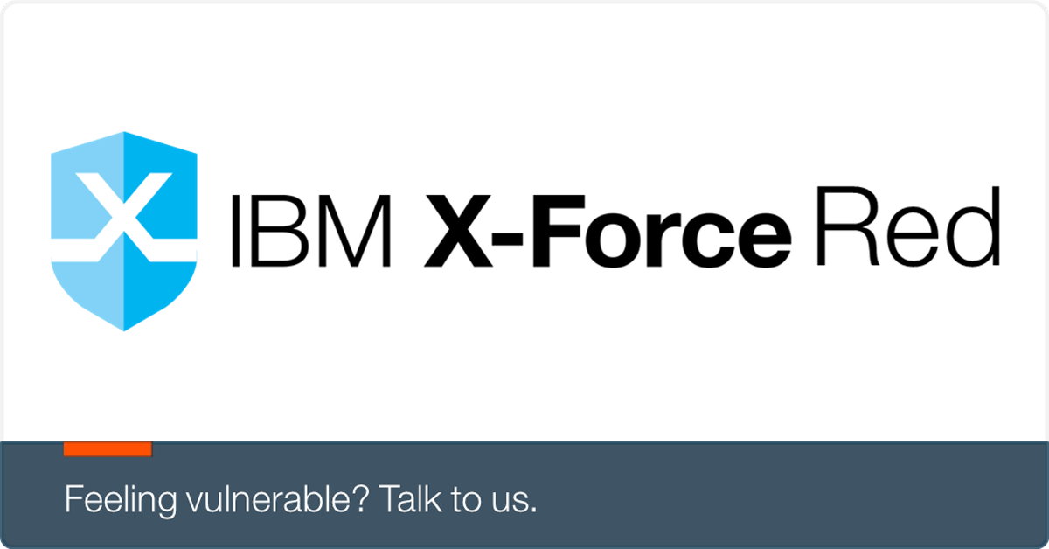
Secure Development Support Services - Requirements Management (3/3) 6948-66Y (8F) 6948-67G (8F GBS) 6948-67C (J6 GTS)
Software Development LifeCycle (SDLC)
End-to-End Integrated
Application Security Solution illustration
Design
Construct
Implement
Pre-Production
Production
Managed Secure Development
As A Service
Application Questionnaire
Defined functional and non-functional requirements published in ALM
Security requirements translated into architecture & design, development and testing tasks
In time Secure coding guidance aligned with security requirements
Tasks synchronization with ALM tools
Tasks verification by importing security testing results
Completed tasks mapping against regulatory requirements for compliance check
A model to continuously assess, identify and mitigate software application threats and validate against established security baseline during the development lifecycle
Threat and
counter-measures DB
App
Profile DB
Software coding,
design guidelines
Cyber Threat Intelligence (CTI)
As A Service
Managed Security Testing
Vehicle software and threat and vulnerability intelligence aggregation and correlation
Source code finger printed
Source code testing automated at developer end
Scheduled scanning of nightly / alpha builds
Scanned results integrated to bug tracker
Black Box
Penetration Testing
IBM X-Force Threat Exchange
White Box Penetration Testing
Validated software
Static code analysis (SAST)
Dynamic and Interactive (DAST / IAST) testing
ICU Integrated Testing
Software vendors, community and other commercial feeds
Automated Security Testing
Pre-production
Penetration testing
Dark web

Slide 27
Application Security Testing Services – Remediation Support (1/2) 6948-66W (8F) 6948-67H (8F GBS) 6948-67E (J6 GTS)
Solution Overview & Capability
Services to provide on-going support in handling activities post-security testing, including findings analysis, vulnerability remediation effort dispatching and guidance, and reporting
Mostly BAU activities following client or IBM defined vulnerability management processes
Selection Criteria & Positioning
Ideal client profile : Client has invested in security testing but low maturity in secure development or vulnerability management
Security testing volume must be significant enough to justify buying remediation support services
“Security Testing Strategy Development” services can be proposed for the T&T phase
Complementary to secure development support services, and IBM X-Force Red Testing services
Scoping & Estimating
On-going services support directly linked to the volume of vulnerabilities found during security testing activities
Services hours estimation proportional to the number of test conducted monthly
Rules of thumb : ~10 hours per test

Slide 28
Application Security Testing Services – Remediation Support (2/2) 6948-66W (8F) 6948-67H (8F GBS) 6948-67E (J6 GTS)
Value Proposition
Outsourcing of non-core business functions to provider with SME resources
Augmentation of IBM managed services capability to cover end-to-end application security needs
Delivery Model
On-going services delivered remotely by GID
Indicative Costing & Pricing Guidance
Pricing mainly based on number of FTE units required to support the BAU processes.
1 FTE can support up to 200 test per year ( ~100k USD per year)
Executive oversight ~5% | Execution supervision ~5% | Delivery ~90%
Local or COC (Band 10-D) | GID (Band 8-9) | GID (Ban 6-8)

